Slide 1
The fourcastrs presents you
Rainfall prediction
Made by
RA2311056010297 Kashyapa Kristipati
RA2311056010302 Kavyashree.P
RA2311056010264 P. Charishka
RA2311056010269 V . Vinithna

Slide 2
ABSTRACT
The project focuses on developing a machine learning model to predict rainfall using historical weather data. The dataset, sourced from Kaggle, includes various meteorological parameters such as temperature, humidity, wind speed, and past rainfall records. By applying data preprocessing, feature selection, and machine learning algorithms, the project aims to build an accurate predictive model. The outcome will help in planning and decision-making in sectors like agriculture, water management, and disaster preparedness.
Keywords: Rainfall Prediction, Rainfall Measure, Rain fall Accurate Results

Slide 3
INTRODUCTION
This project leverages historical weather data to build a machine learning model that predicts rainfall. By analyzing patterns in the data, the model aims to provide reliable forecasts that can be used to improve preparedness and resource allocation.
key Objectives
Develop a High-Accuracy Predictive Model
Identify Significant Weather Patterns
Provide a Practical Forecasting Tool

Slide 4
Problem statement
Accurate rainfall prediction is a complex but essential task that impacts various sectors, including agriculture, water resource management, disaster preparedness, and urban planning. Traditional methods of weather forecasting often struggle to predict rainfall with high precision, especially in regions with volatile weather patterns. This project aims to address this challenge by leveraging machine learning techniques to build a predictive model that can accurately forecast rainfall based on historical meteorological data. The objective is to create a reliable and efficient tool that can assist in better planning and decision-making, ultimately helping to mitigate the adverse effects of unpredictable rainfall.

Slide 5
Process
Data Collection: Obtain the dataset from Kaggle, which includes various meteorological features and rainfall data.
Data Preprocessing: Handle missing values, outliers, and inconsistent data.
Normalize or standardize the data as required.
Split the data into training and testing sets.
Exploratory Data Analysis (EDA): Visualize the data to understand relationships between features. Identify trends, correlations, and patterns that may influence rainfall.
Feature Selection: Select relevant features that have the most impact on rainfall prediction.

Slide 6
Process
Model Development: Choose appropriate machine learning algorithms (e.g., Linear Regression, Random Forest, or Neural Networks). Train the model using the training data.
Prediction and Deployment: Use the trained model to make rainfall predictions on new data.

Slide 7
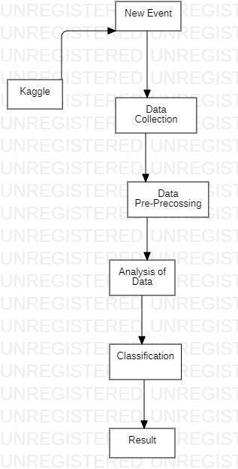
System Architecture
Here is an flowchart of the whole process
of the project.

Slide 8
conclusion
In this project, we successfully developed a machine learning model for rainfall prediction using a comprehensive dataset from Kaggle. By applying rigorous data preprocessing, feature selection, and model optimization techniques, we were able to achieve a high level of accuracy in our predictions. The model not only identifies key meteorological factors influencing rainfall but also serves as a practical tool for various applications, including agriculture, water management, and disaster preparedness.

Slide 9
references
Websites
Software and Tools
use of software and tools like Gemini and Black box .
Machine learning platforms.
Jupyter notebook ,
Matplotlib
Source extracted from default platforms
geeks for geeks and
Kaggel
Researchgate publications
International Journal of Scientific Research in Engineering and Management (IJSREM)

Slide 10
Thank you
Made by
The Fourcasters

